Slide 1


Call for Evidence on Future Energy Consumer Protections

Slide 2
Background & Introduction
DfE published (Jan 2022) Energy Strategy Action Plan for 2022
22 in actions in total – each should be “consumer-centric” in approach.
Action 3 – “issue a call for evidence on protection for consumers during energy decarbonisation” –
Joint UR/CCNI delivery – have worked collaboratively to agree and develop the CfE & Literature Review
To include Lessons Learned from other jurisdictions – taking the form of Literature Review
Aim: gather evidence to assess the future need for the protection of energy consumers during the transition to energy decarbonisation

Slide 3
Structure of CFE
To provide context for this CfE, and to aid respondents to provide evidence, we have considered:
  The current consumer protection landscape;
  Potential principles and goals for energy consumer protection in a future-looking context;
  In addition, tried to help readers order their thoughts by Using 3 “Dimensions” for future consumer protection considerations:
    Coverage in terms of Energy type /sectors/technology;
    Business practices (with consumer impacts/outcomes); and
    Which groups of energy customers need covered.

Slide 4
Timelines for project
Phase 1 (current year 2022):
  The UR, CCNI and DfE have collaborated to establish the form of the CfE. Desk research has been undertaken to help identify what lessons can be learned from other jurisdictions.
  This CfE has been developed and published to meet the Strategy Action Plan Action 3 commitment for delivery by December 2022.
  NB - Deliberative consumer engagement (led by CCNI) will be undertaken beginning in 2023 post publication of CfE

Slide 5
Timelines for project
Proposed Phase 2 (2023 & 2024):
  Stakeholder engagement sessions prior to the response deadline for this CfE (CCNI lead).
  Analysis of responses to the CFE
  Potential further research, if deemed necessary, based on the responses received.
  Workshop(s) with the wider energy sector to support development of options for a formal consultation on potential future protection framework.
  UR, CCNI and DfE in-depth collaboration to frame the policy consultation.
  Potential Workshops / discussion during consultation window

Slide 6
Timelines for project
Proposed Phase 3 (2024) – Delivery
  Decisions made based on the results of the options consultation.
  Program for delivery of framework established.
  Implementation of framework.

Slide 7
Current Framework for Protection
UR | CCNI | Trading Standards | CMA
Licence Conditions Place consumer protection related requirements on NI electricity, gas and water companies | Energy Order requirements including investigating complaints and ensuring legislation and regulation works effectively for consumers. | Ten coverage areas relevant to energy including Pricing, misleading information, unfair contract terms. | Works to ensure consumers get a good deal when buying goods and services, and that businesses operate within the law.
Codes of Practice (for example including one for energy consumer Complaints handling, and one for energy company Marketing practices) | Particular regard for: Disabled or chronically sick; Consumers on low incomes; Rural consumers. | Trading Standards do not investigate every complaint received and so have to prioritise work accordingly. | Works with statutory organisations and businesses to maintain effectiveness of markets and competition for consumers.
Price Controls Ensure prices are as low as possible | No statutory duty on home heating oil but issued Consumer Charter on oil with NI Oil Federation. This is a voluntary Code of Practice. | Decisions to act underpinned by information and evidence gathering. | Normally address breaches through mediation. No powers to fine companies for non-compliance (unlike many other countries). Has ability to ask courts for an enforcement order.
There are protections set out in consumer law which contribute to a ‘toolkit’ that can be utilized for energy consumers.
The requirement for greater partnership working across and between these organisations will need explored.

Slide 8
CFE – key aspects in document
All consumers will require some level of baseline protection regardless of the how they obtain their energy or what they are using energy for – “the general protection principles”.
Scoping the CFE is a key challenge due to breadth of potential issues to be covered. To try to provide a framework, the CFE considers 3 dimensions to protection:
Coverage of future CP framework: These include the different reasons for energy use e.g. Heat, and the different technologies/sectors consumers will use to access and obtain energy.
Energy company Business Practices: The different mechanisms a supplier will engage with a consumer to achieve outcomes for that consumer.
Consumer Groups: The different consumer types beyond just all consumers including vulnerable; industrial/commercial; microbusiness; public sector; voluntary/community sector.

Slide 9
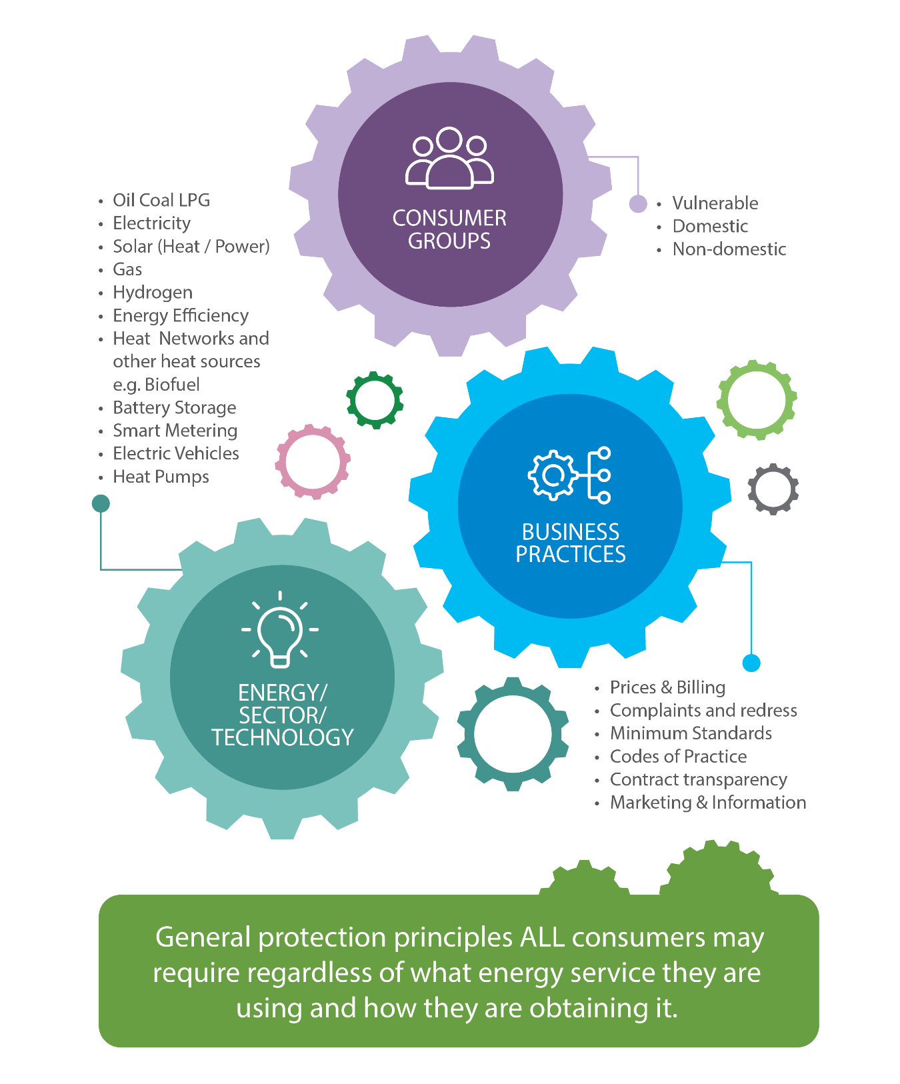
The 3 dimensions

Slide 10
Lessons Learned from other Jurisdictions Overview
As included within the detail of Action 3, part of the DFE requirement entails research on lessons learned in other jurisdictions.
Undertaken to serve as the evidence basis for content within the CFE.
Examined overall principles & goals of consumer protection to meet net zero as well as three dimensions of: coverage areas, business practices, and consumer groups.

Slide 11
Key Findings & Lessons Learned
Overall principles and goals for consumer protection in a net zero world
May need a Hybrid of a principles based approach with guidance on how apply, and rules for specific higher risk areas – vulnerable or a crisis eg COVID-19
A number of examples of principles examined but all entail focus on:
  Fair treatment (Working for the consumer rather than exploiting them);
  Inclusivity, empowerment and access through clear, useful and usable information, education and data utilisation in a way that is protected;
  Appropriate complaints and redress mechanisms.

Slide 12
Key Findings & Lessons Learned
Dimension 1: Coverage of future protection requirements (Tech; Sector; Heat)
Needs to be uniform implementation of best practice/central (mandatory accountability?) codes of practice for suppliers and installers linked to a trusted quality logo.
Whether used for energy today (e.g. oil) or possibly used in the future (e.g. hydrogen), no consumer should be left behind in protections they are offered compared to others.
Consumer choice on their energy source or technology should be informed rather than restricted as part of any future protection framework.

Slide 13
Key Findings & Lessons Learned
Dimension 2: Business Practices
Transparency of pricing and contracts v important; consideration of price regulation needs & price transparency.
Clear, easy to access, accurate information and advice
Simplicity and transparency of information crucial to consumers ability to understand and compare products and services.
Reporting & Monitoring from energy providers (through structured and mandatory collection of information) against requirements are essential.
GB consumers are able to register complaints that have not been satisfactorily resolved with an energy ombudsman. Not available in NI.

Slide 14
Key Findings & Lessons Learned
Dimension 3: Which consumers to protect
All consumers: Hybrid based approach sets out the minimum standard of services which can also be tailored to individual customer needs.
Vulnerable consumers: Certain consumer groups are at particular risk of being excluded from consideration of what they need precisely as a consequence of vulnerability. Consumers can also be put in a vulnerable situation by how they are treated by energy companies.
Domestic consumers: “One-size-fits-all” is inappropriate, but cannot be uneven application of best practice. However clarity on what is expected from suppliers crucial for implementation and delivery.

Slide 15
Key Findings & Lessons Learned
Dimension 3: Which consumers to protect
Non-Domestic
  Business Sector: Have specific energy requirements with potentially little scope for reducing or adapting usage. Requirement for transparent / accessible information. Issues with long contract durations, and vulnerability to poor outcomes due to aggressive third party intermediary tactics. Need for adequate dispute resolution.
  Public Sector: May face specific challenges when purchasing energy using call off framework. Difficulties in obtaining energy could lead to the provision of skeleton services.
  Voluntary/Community Sector: May not have the same purchasing powers as larger more well-resourced organisations. Possible lack of incentives for making energy efficiency purchasing decisions if tenants housed in leased premises.

Slide 16
Next Steps
We are seeking views to the call for evidence on or before 01 March 2023.
Please send responses to liam.gault@uregni.gov.uk.
Alternatively, you may also provide your views through the CitizenSpace online portal.

