Slide 1
NI TSO Price Control Stakeholder Expert Challenge Group (SECG)1
25 September 2018

Slide 2
Agenda
Time | Topic | Speaker(s)
2:00 Registration/tea/coffee
2:10 | Welcome & introductions | Jenny Pyper Tanya Hedley Roundtable
2:35 | SECG context & role | Ciaran MacCann
3.15 | UR role, regulatory framework & developments | Jody O’Boyle
3.35 | TSO roles, characteristics and challenges | SONI
4.05 | Next TSO price control | Ciaran MacCann & SONI
4.50 | Next steps and closing remarks | Tanya Hedley

Slide 3
UR Team
Jenny Pyper CEO
Tanya Hedley Director Networks
Ciaran MacCann Project Management & Analysis
Jody O’Boyle Manager Networks
Caspar Swales Manager Networks
Roy Colville Analysis
Aidan Girvan Analysis
Natalie Dowey Analysis

Slide 4
Session 1
Stakeholder Expert Challenge Group (SECG) context and role

Slide 5
Strong precedent for effective engagement
Enhanced consultation between regulator and experts to develop and challenge aspects of its policy
Expert technical review and challenge
Increase business plan quality and justification
Support UR assessment of the business plan

Slide 6
SECG offers a diversity of perspectives
Insight and challenge
Technical clarify, define and challenge TSO roles, services, activities and performance.
End consumer how current and future consumers (incl vulnerable) are affected and use TSO service
Regulatory policy knowledge of best practice and experience
Service user
how customers affected and use TSO service

Slide 7
How we expect SECG to engage
Not a forum for SONI to develop and test its business plan during development & offer advice to SONI
Participants should be individuals as far as practicable
Group is not a decision making body (rests with UR)
Dialogue should be constructive

Slide 8
Proposed phases for engagement
1. SECG insight & challenge into UR approach
2. SONI submit business plan to UR and SECG
3. SECG challenge business plan
4. UR consider SECG views as part of its wider evidence base for Draft Determination
5. UR provides its formal view of business plan in DD
Sep 2018 to Feb 2019
End July 2019
End September 2019
?
End September 2019 to December 2019
End December 2019
We will clarify and confirm the specifics of how steps 2, 3, 4 and 5 will work during the approach phase

Slide 9
Declaring and managing interests
We have asked participants to declare interests and will publish these on our website
Participants should inform us of change in interests during the process
Participants should disclose any previously undisclosed interests where there may be a conflict during meetings
We will take account of participants ability to act independently (e.g. using participant evidence to inform our business plan assessment)

Slide 10
Confidentiality
We will seek relevant party consent where we are minded to publish information which could be confidential
We welcome SECG participant views on whether participants should sign an agreement on non-disclosure
During phase 1 we will also consider how confidential information is treated as part of phases 2 to 5 (as described on slide 8)

Slide 11
Q & A
Do you have any questions on the role and purpose of the SECG, and interests and confidentiality?

Slide 12
Session 2
UR role, regulatory framework & appeal, and recent regulatory developments

Slide 13
UR role and objectives
Principal objectives (Article 12 of Energy Order)
Protect the interests of consumers of electricity
Promote effective competition (where appropriate)
Regulatory duties
We also have duties in carrying out our functions & furthering our objectives:
  E.g. financeability
  E.g. promoting the efficient use of electricity and efficiency and economy in the transmission and supply of electricity

Slide 14
UR Corporate Strategy 2014-2019
Objective 1
Encouraging efficient and effective monopolies
Objective 2
Promoting efficient and competitive markets
Objective 3
Protecting the long-term interests of business and domestic consumers

Slide 15
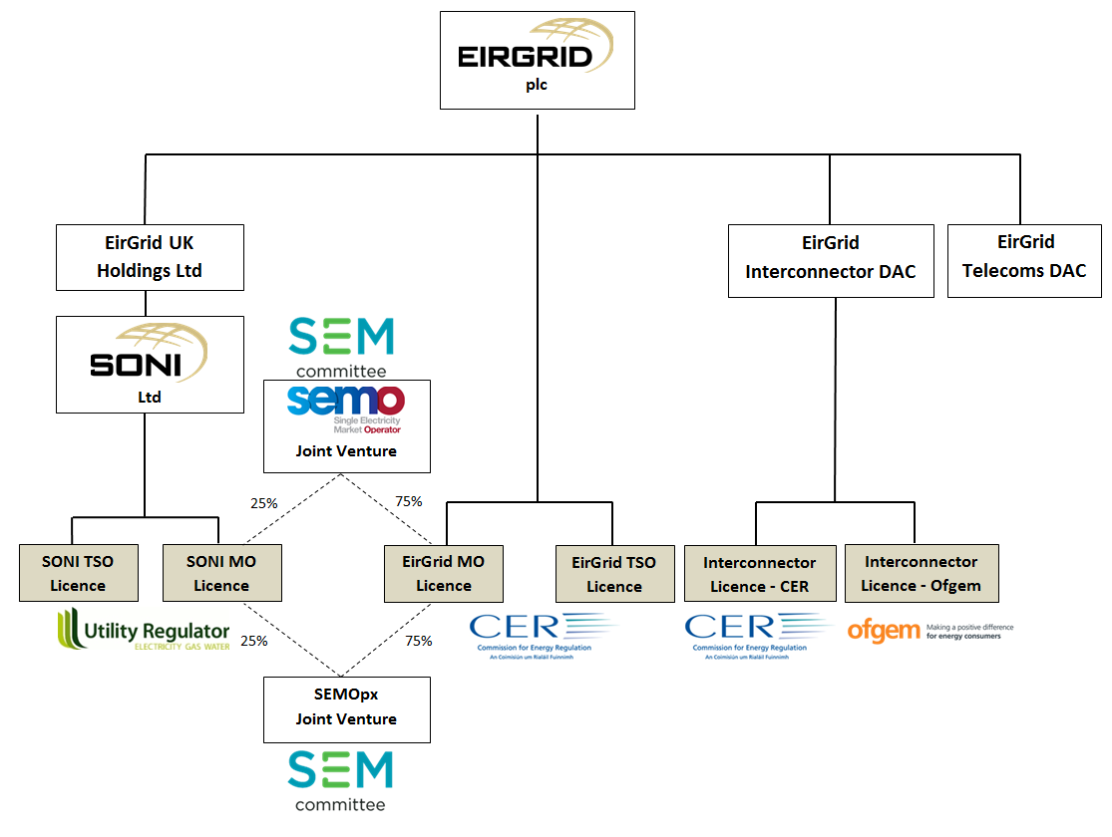
SONI within wider regulatory framework & corporate structure
The NI TSO price control covers SONI TSO functions, activities, incentives and associated costs

Slide 16
Simplification of TSO price control with CMA remedies
Revenue = Allowance +Uncertainty +Incentives + Remuneration
Up-front allowance with 50:50 cost risk sharing applied
A ‘Dt’ mechanism & ‘K’ factor
Dispatch Balancing Cost (DBC) reward & penalties (SEM matter)
Uplifted WACC * RAB
CMA provided more allowance for pension deficit repair (error 10) and inflation aspect of (error 11)
CMA required be clarification and codification in greater detail Dt and TNPP & found Dt & TNPP asymmetric risk (error 2 & 6)
CMA provided additional remuneration for PCG, asymmetric risk on Dts + TNPPs, Collection agent risk

Slide 17
We are reviewing SONI governance and cost reporting
We aim to publish a consultation on SONI governance shortly
We have published consultation to require annual TSO cost reporting (RIGs) for the 2015 to 2020 period
We will publish our decision for the TSO cost reporting this year.

Slide 18
Q & A
Do you have any questions on the UR role, regulatory framework and wider regulatory developments

Slide 19
SONI: Our role, key responsibilities and potential future challenges
SONI Price Control Stakeholder Expert Challenge Group
25 September 2018

Slide 20
Price Control Introduction
Provide a brief overview of the activities that SONI undertakes as TSO
Highlight some current developments
Key challenges we see emerging over 2020–25 horizon
We are happy to hear about challenges facing wider industry and welcome your input to the next PC

Slide 21
SONI’s Role
Autumn 2018

Slide 22
Overview of SONI TSO Functions
Economic, Efficient & Coordinated System
Connections
Network Planning
Network Projects
Forecasting and Outage Planning
Scheduling and Dispatch
Corporate Functions

Slide 23
Connecting Customers to the Transmission Network
application
Feasibility studies
Support customers with the process
offers
Contractual counterparty for customers
energisation
Compliance testing
Enduring rights for use of system
…… while focusing on customer requirements

Slide 24

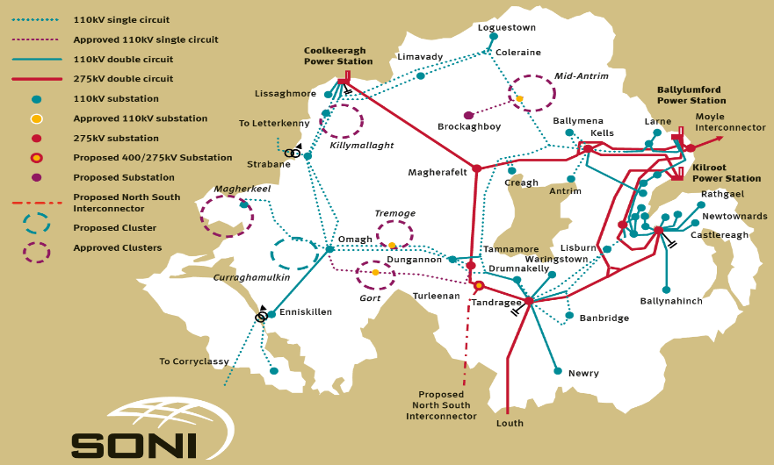
Planning the Transmission Network
SONI is responsible for the planning standards
Plans the network to meet these standards
Reviews NIE Networks’ asset management plan and co-optimises projects
Identifies essential development projects
Publishes information for stakeholders

Slide 25

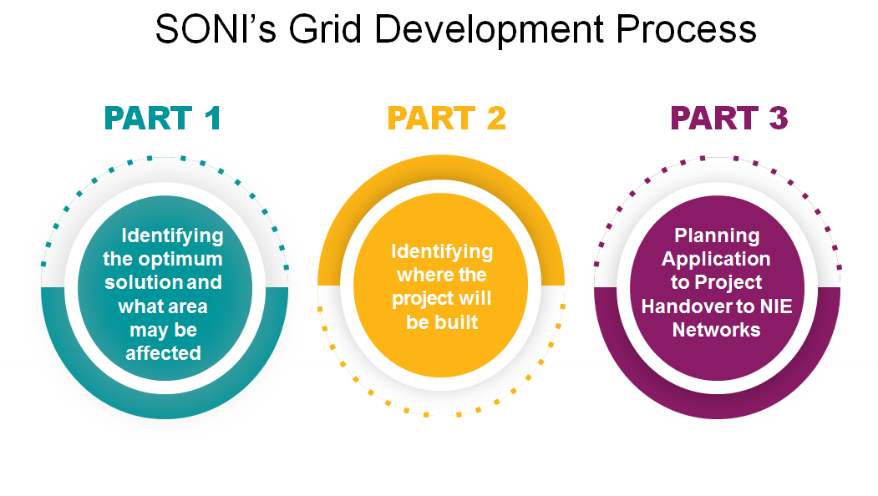

Network Projects
SONI is responsible for network development projects up to the point where consents are obtained

Slide 26

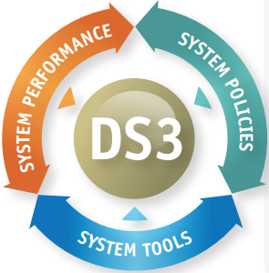
Ensuring the Secure Operation of the System
Generation adequacy assessment
System services procurement
Outage planning
Forecasting
  Demand
  Wind
  Solar

Slide 27
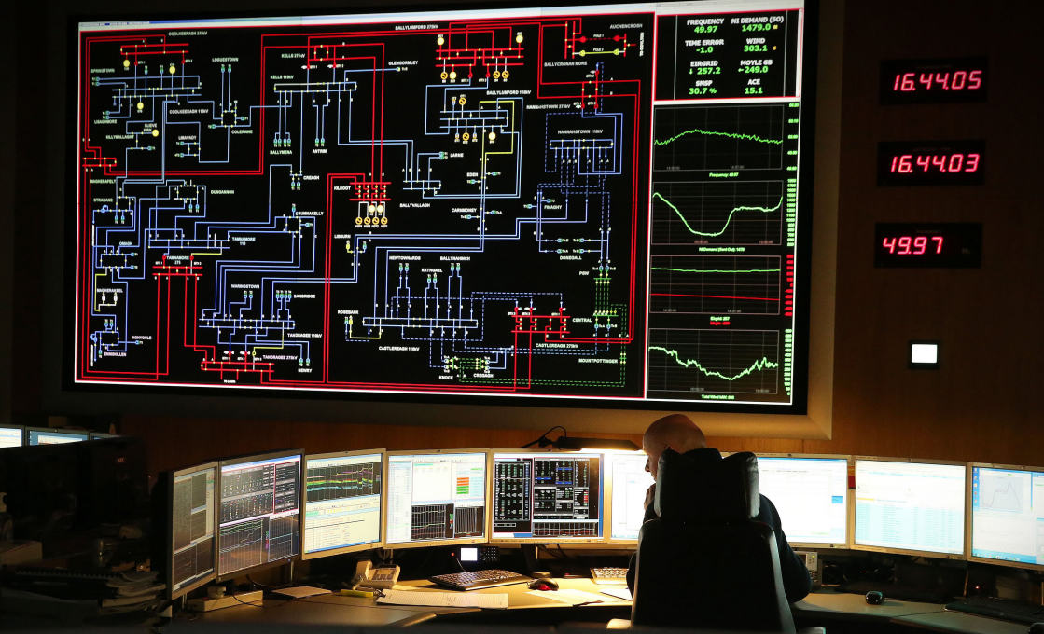
Real Time System Operation
24/7/365 Operation
Objective is to minimise cost of deviation from the ex-ante market outcomes, while respecting
  System security
  Network constraints
  Outages
  Priority dispatch

Slide 28
Corporate Functions
Finance, Legal & Procurement
Regulation & External Affairs
IT, HR, Facilities
Invoicing and Settlement for TUoS and System Services

Slide 29
What SONI TSO Does NOT Do
Plan network maintenance or asset replacement
Settle the CRM or Balancing Market
Build or own network assets
Contract directly with generators for energy

Slide 30
Ongoing Developments
Autumn 2018

Slide 31
Current Developments
I-SEM Operations
DS3 Implementation
EU Network Codes (IME3)
Annual Cost Reporting (RIGs)
Capacity Market Operation
Increasing Financial Responsibility
Notes:
I-SEM
DS3: On Monday 9th April 2018, the grid operator in Northern Ireland, SONI, and the grid operator in the Republic of Ireland, EirGrid, confirmed that up to 65% variable renewable energy can be handled on the all-island grid at any given time. This is predominantly made up of wind power, along with contributions from solar and interconnector imports.
The move to 65% follows the successful completion of a five-month trial, during which SONI tested its ability to handle the 65% limit. Several new all-island wind energy records were set during the trial, including the current record of 3,655 megawatts on 14 March.
The power system is the first in the world to reach this level, making this a ground-breaking achievement. We look forward to continuing progress towards 75% variable renewable energy on the grid over the coming months and years."

Slide 32
Key Facts
 | 2015 | 2018
% of non-synchronous generation | 50% | 65%
Number of transmission connection applications | 3 | 10
System Services Budget | £18 M | £38 M
Number of Dispatchable Generators in NI | 61 | 86
Dispatch Balancing Costs (all-island) | €170 M | €231 M

Slide 33
Key Challenges
2020 - 2025

Slide 34
challenges
External
Policy, Political & legislation
Technical
System Operation Developments
Business
Risk, costs, incentives

Slide 35
Political, Policy and Legislative Challenges
Clean Energy Package
Brexit
Unknown government policy direction
Planning permission framework in NI
Public acceptability of transmission infrastructure

Slide 36
System Operation Challenges
Ensuring Security of Supply
  Plant retirements
  Delivery of new connections
  Managing active demand side market participation
Changing demands on the power system
System Operation in the Context of I-SEM
The next asynchronous challenge
Innovation

Slide 37
Business Challenges
Continued business change and adaptability
Management of risk within that change process
Regulatory framework appropriate for the business
Continued efficiencies/ synergies
Cyber security
Innovation

Slide 38
Discussion

Slide 39
Session 4
Next TSO price control: effective outcomes; scope of issues for approach and SECG; and timetable

Slide 40
Key outcomes for effective price control
Confidence that costs recovered are reasonable
Confidence that the TSO is providing high-quality service and performance which improves over time
Confidence that the framework provides TSO investors with a fair package of remuneration and risk
Confidence that what TSO does meets customer expectations and is aligned with system wide interests
Greater transparency on TSO service and costs

Slide 41
Guiding framework & process design principles
Transparency | Heightened visibility and clarity of TSO services and costs Explore opportunity for further transparency of UR processes and deliverables
Certainty and consistency | Credible and coherent price control package which is tailored to the TSO Builds on 2015-2020 framework, with well targeted adaptation Predictable price control framework which can act as a platform for further development
Proportionality | Consider insights from other regulators, whilst being proportionate and focusing on what is achievable and effective
Accountability | Confidence that SONI and UR and decisions are well justified and subject to appropriate level of scrutiny Effective and meaningful stakeholder engagement supported by positive working relationships No delays in UR formal determination

Slide 42
The Price Control

Slide 43




What SONI Provides for Customers
Cost
  SONI’s internal costs are approx. 1% of annual bill for domestic customers
  SONI influences up to 60% of the cost to end users
Quality
  ensures reliability of supply on par with Tokyo and Taiwan; and
  maintains quality of electricity on par with the US and Germany.
Environment
  SONI has safely incorporated world leading amounts of wind generation
Security & Reliability
Community & Environment
Costs & Efficiency

Slide 44
What This Price Control Needs to Achieve
A strong TSO for NI to 2025 and beyond
Provision of efficient levels of revenues to enable key outputs/ outcomes to be achieved
Framework which handles and is capable of dealing with uncertainty
A financeable regulatory framework
Appropriate incentives and incentive frameworks
Frameworks for the next evolution of the industry
  Continued power system evolution
  Contestable Networks

Slide 45
How we will prioritise areas with SECG
Context and background
The role and services of the TSO
Scope, form and duration of TSO control
Use of framework to achieve good outcomes
Use of uncertainty mechanisms to manage risk
Approach to cost assessment
Approach to remuneration of financing costs
Approach to financeability assessment
Business plan expectations,assurance,assessment
Price control review process
Sep SECG
Lighter discussion
Oct & Nov SECG
Detailed discussion
Oct & Nov SECG
Minded to consultation position
Nov SECG

Slide 46
Understanding roles, services and scope with SECG can add value
Create stronger narrative within price control of what is expected from TSO as a service provider
Support work on price control framework, remuneration and risks work
Inform potential for assessing and benchmark TSO performance & explore where promoting “good behaviour” may be appropriate
Test and refine certain aspects of TSO role and potentially identify where competitive constraints may be feasible and add value
Clarify price control boundaries and link between costs and services

Slide 47
Greater focus on business plan expectations, assurance & assessment
High consumer interest with relatively less focus to date
Regulatory precedent suggests focus can improve outcomes
We will explore adaptability of UR precedent along with examples from other regulators
We are considering value of business plan scorecard approach with incentives; transparency measures; and stronger governance assurance

Slide 48
Proposed project timetable
Interdependency: 2015-2020 Cost reporting submission from SONI end Q1
Publish approach consultation December
Publish approach decision February
FD publication end May
2018
2019
2020
Approach
Interdependency: SONI submit business plan to UR and challenge group end of July
Enhanced stakeholder engagement
Draft Determination
Final Determination & Licence mod
Interdependency: UR submit business plan templates end of February (with approach decision)
DD publication end December
Price control starts 1st October

Slide 49
Q & A
Do you have comments and agree with UR:
  outcomes of an effective TSO price control
  guiding principles?
  scope of the approach and how we intend to cover issues with the SECG?
  project timetable?
Do you have any comments on SONI’s price control presentation?

Slide 50
Next steps
We will publish minutes (agreement markers and actions)
23 October and 28 November meetings are in diaries (to take place at UR between 10am and 4pm)
UR to circulate material for the 23 October SECG on 16 October.
To stimulate thought between now and October meeting see some of the areas we are currently minded to discuss and supporting material in annex

Slide 51
Thank you for your time!

