Slide 1
TSO Price Control Stakeholder Expert Challenge Group (SECG)1
25/09/2018

Slide 2
Annex: supporting slide content and cross references
Slides 3 to 5 support slide 16 of main slide deck.
Slides 6 to 7 support slide 46 of main slide deck.
Slide 8 supports slide 45 to 47 of main slide deck.

Slide 3
Annex: uncertainty: Dt process
The UR gives approval of an allowance up to a cap (FD 444) (including contingency - Defense).
SONI increases SSS tariff
SONI incurs costs
SONI reports the actual cost
(K factor mechanism for the under variance)
SONI submits Dt claim during price control period
UR approval of an allowance up to a cap (& contingency)
Dt submissions require approval of the UR before they become effective within tariffs.
Submissions must meet threshold of £40k
Category of claim defined in FD but ‘catch all’ in TSO licence’
UR assess requests and provide appropriate approval if its is determined to be in the public interest of the consumer - ‘ex-ante cap’
SONI increases SSS tariff & incurs costs
K factor used to recover underspend not overspend
K factor mechanism also includes a ‘demonstrably inefficient clause’, which allows for adjustments should certain costs be determined to be demonstrably inefficient or wasteful expenditure
50/50 risk sharing mechanism does not apply to Dt mechanism
If during life of project SONI finds cap is too low – SONI makes further Dt application to increase cap
Notes:
Dt claim by 1 April – for changes to take effect on the tariff from October following year

Slide 4
Annex: uncertainty: TNPP process
Projects will be reviewed by UR and will be placed on TUoS tariff through transmission interface arrangements. Project Construction will follow the NIEN D5 approval mechanism
UR will continue to work with SONI and NIE to develop the pre- construction / construction project provisions
Projects will be reviewed by UR and will be placed on TUoS tariff through transmission interface arrangements. (FD483)
UR will continue to work with SONI and NIE to develop the pre- construction / construction project provisions (FD 485)
SONI Conducts planning work
& UR gives approval to increase SSS tariff
Project given approval by UR to proceed to construction
SONI identifies potential project and seeks TNPP approval from UR
Project costs recovered from NIE (TuOS)
Project costs recovered from NIE (TuOS)
Decision on whether project will proceed to construction
Actual project costs recovered through SSS (including RAB)
Actual project costs recovered through SSS
SONI required to obtain UR approval upfront for each project
UR will assess if project is in the interests of consumers and if potential alternatives
UR will determine appropriate upfront cost allowance (including contingencies)
Project deemed no longer viable
Costs associated with TNPPs will accumulate on a separate RAB until a decision is made whether they will move to construction.
SONI can submit additional TNPP claims if unexpected TNPP costs develop beyond the cap. UR would assess if approval of such claim was in the customer interest.
Project costs will be reviewed by the UR and if efficiently incurred will be placed on the SSS tariff.The allocation of actual costs to the projects may also be further audited if it is deemed appropriate to do so

Slide 5
Annex: CMA required UR to codify Dt and TNPP separately via guidance and licence
Timelines
Ongoing reporting
Transfer of investment into capital base
Project specification & project variation
UR detailed guidance (backed up by licence)

Slide 6
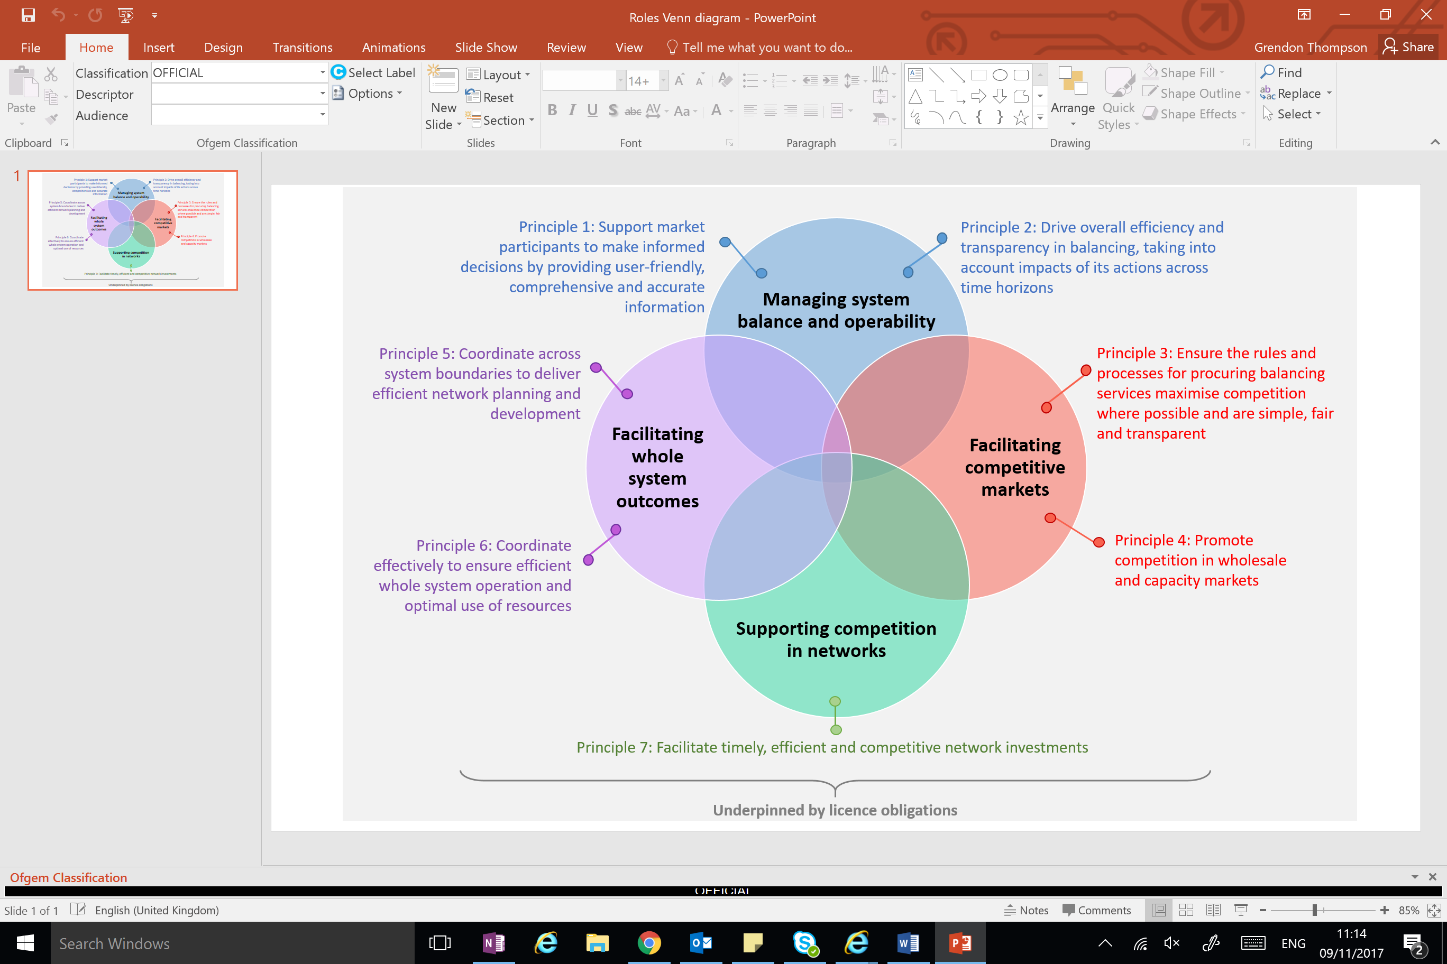
Annex: example of National Grid (ESO) roles
OFGEM EXAMPLE - Annex
https://www.ofgem.gov.uk/system/files/docs/2018/02/eso_roles_and_principles.pdf

Slide 7
Annex: National Grid (ESO) services
See page 13 below for a recent example of a perspective of National Grid (ESO) services
https://www.ofgem.gov.uk/system/files/docs/2018/07/reckon_final_eso_report_20jun2018.pdf

Slide 8
Annex: current thinking* on potential areas for discussion with SECG
Roles, services and scope | Business plan expectations, assurance and assessment | Approach to financing costs and financeability
Defining roles of NI TSO Defining services of NI TSO Identifying the beneficiaries and benefits of roles and services Examples of behaviour, performance, outcomes and outputs How roles and services and behaviour may be affected in the future Potential for competitive constraints Comparison between NI and GB TSO | Expectations of what a more service-focused business plan should look like Governance and assurance Expectations on transparency (SONI and UR processes and deliverables) Business plan scorecard and role of incentives Role of SECG | Principles for approach to financing costs Assessment of whether the price control is financeable. Remuneration of the TSO’s financing costs. Debt financeability analysis. Analysis of potential scenarios for returns on regulatory equity (RoRE). Assessment of the financial resilience of the actual licensee.
* This is a current view to provoke thought and we may refine/add or remove issues for future SECGs.

